Slide 1

Research on the Influence of Recommended Online Testing and Evaluation on College Students' Purchase Intention of Beauty Products.
推荐型网络测评对大学生购买美妆产品意愿的影响研究
Yingzhi Guo ^{1,}*, Master Student, Sichuan University
Yongzhong Yang ^{2,}*, Professor, Sichuan University
Kunming Luo ³, Doctoral Student, City University of Macau
Notes:
幸运日素材 淘宝店：https://shop145643496.taobao.com

Slide 2

CATALOGUE
Introduction
Literature Reviews and Research Hypothesis
Research Design and Empirical Analiysis
Conclusion and Future Work

Slide 3
01
Introduction

Slide 4
Background
Decentralization:
New information subject is wandering, decentralized and deauthoritative (Poster, 1995).
College students have become one of the major consumer groups:
In recent years, consumer group of beauty products has gradually tilted towards young women, especially campus women.
At the same time, public data shows that the economics of male beauty is rising.
College students prefer to refer to OTE to obtain information about beauty products:
Limited economic conditions
The diversity of beauty products

Slide 5
Theoretical Significance
Fill a gap in the literature for in-depth analysis of emerging things like online testing and assessment.
Our research considers the increasingly important role of ordinary people in the dissemination of information on the Internet, rather than just focusing on key opinion leaders
Contribution
Practical Significance
For operators, from the perspective of consumers, we can find a scientific way to improve their purchase intention
For college students, provide pre-purchase information to help them make satisfactory decisions

Slide 6
02
Literature Reviews and Research Hypothesis

Slide 7
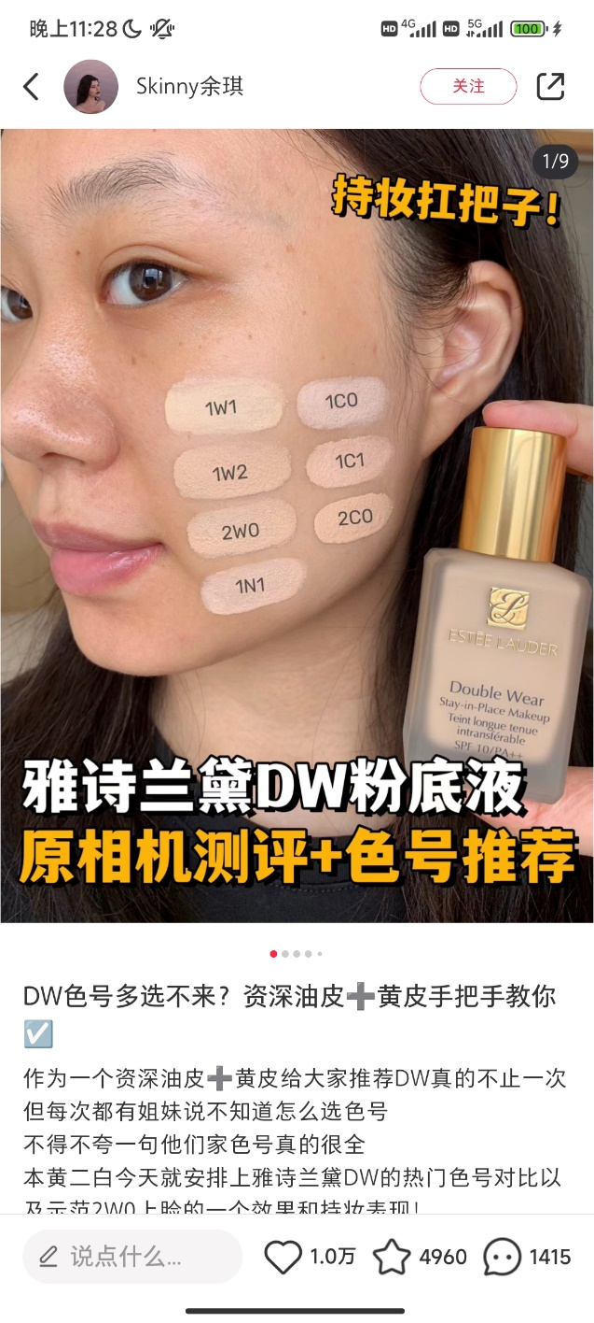
Online Testing and Evaluation (OTE):
Definiton:
UGC
OTE refers to the testing and evaluation of beauty products displayed by any netizen through Internet channels.
After using the product, the users spontaneously conduct a comprehensive analysis of the product's appearance design, efficacy, price, ingredient safety and other dimensions.
Measurement:
Professionalism- knowledge, ability and experience (Netemeyer & Bearden, 1992)
Popularity- social status, public familiarity and celebrity effect (Meng, 2012)
Content quality- authenticity, objectivity and usefulness (Guo and Li, 2013)
Visual cues- readability, richness, and intuitiveness (Meng, 2012)
P.S: “OTE” ≠ “Unboxing”
Unpacking (Marsh, 2016)
Emotional value (Vaudrey, 2022)
No requirement for in-depth exploration and evaluation (Vaudrey, 2022)

Slide 8
Purchase Intention:
Definition:
the possibility and subjective tendency of consumers to make a purchase decision, which is often used to predict actual consumption behavior (Mullet & Karson, 1985).
Measurement:
purchase impulse, priority, continuing purchase and recommending to others (Zeithaml, Parasuraman and Malhotra, 2002)
Hypothesis:
H1: Professionalism has a significant positive impact on purchase intention.
H2: Popularity has a significant positive impact on purchase intention.
H3: Content quality has a significant positive impact on purchase intention.
H4: Visual cues have a significant positive impact on purchase intention.
Regarding the characteristics of OTE subjects, some studies show that consumers' purchase intention is more likely to be influenced by the opinions of experts than non-experts (Bansal & Voyer, 2000). That is, professionalism may have a positive impact on purchase intention. Popularity reflects the degree to which the subject is loved, sought after or trusted by the masses. Consumers may regard the opinions of famous people as reliable sources of information (Till, 1998), so they are more willing to follow their choices and enhance their purchase intention (Meng, 2012). Regarding the characteristics of OTE information, Davis and Khazanchi (2008) defined visual cues as any image-related communication means used to enable consumers to get visual sensory stimulation, which can positively affect consumers' cognition and purchase intention. In addition, as a source of information, the content quality is the persuasiveness implied in the information (Bhattacherjee & Sanford, 2006), which can positively influence consumers' purchase intention (Gomes, Marques, & Dias, 2022).

Slide 9
Perceived Risk:
Definition:
first expressed by American scholar Bauer (1960) as that consumers cannot accurately predict the correctness of the results when making purchase decisions, and the unexpected results may not bring consumers satisfaction.
Measurement:
financial risk, functional risk, time risk and psychological risk
Hypothesis:
H5a: Professionalism has a significant negative impact on perceived risk.
H5b: Popularity has a significant negative impact on perceived risk.
H5c: Content quality has a significant negative impact on perceived risk.
H5d: Visual cues have a significant negative impact on perceived risk.
H6: Perceived risk has a significant negative impact on purchase intention.
H7a: Perceived risk plays a mediating role between professionalism and purchase intention.
H7b: Perceived risk plays a mediating role between popularity and purchase intention.
H7c: Perceived risk plays an intermediary role between content quality and purchase intention.
H7d: Perceived risk plays a mediating role between visual cues and purchase intention.
Some scholars have proved that the popularity and expertise of opinion leaders are important dimensions to reduce risk perception of products, and positively affect purchase intention through the mediating role of perceived risk (Biswas, Biswas, & Das, 2006). Chen, Tsai and Lin (2017) has proved that high-quality positive information delivered by opinion leaders can inhibit consumers' perception of risk, and perceived risk has a negative impact on purchase intention. In addition, Pahlevan Sharif and Mura (2019) demonstrated that perceived risk plays a mediating role in the positive impact of information characteristics of user-generated content on purchase intention.

Slide 10
Perceived Functional Value:
Definition:
subjective utility evaluation generated by consumers after comprehensively evaluating the perceived profit and loss of a product or service (Zeithaml, 1988)
Measurement:
efficacy, practicality, and compliance with expectations (Sweeney & Soutar, 2001)
Hypothesis:
H8a: Professionalism has a significant positive impact on perceived functional value.
H8b: Popularity has a significant positive impact on perceived functional value.
H8c: Content quality has a significant positive impact on perceived functional value.
H8d: Visual cues have a significant positive impact on perceived functional value.
H9: Perceived functional value has a significant positive impact on purchase intention.
H10a: Perceived functional value plays a mediating role between professionalism and purchase intention.
H10b: Perceived functional value plays a mediating role between popularity and purchase intention.
H10c: Perceived functional value plays a mediating role between content quality and purchase intention.
H10d: Perceived functional value plays a mediating role between visual cues and purchase intention.
Pan (2023) pointed out in her research that the higher the professionalism and popularity of anchors, the more consumers perceive the functional value, and thus increase their purchase intention. Wang (2020) conducted a comprehensive study on the mediating role of perceived functional value between information characteristics and purchase intention. Her research results show that the quality and presentation of information can help enhance consumers' perception of functional value, and play a positive impact on purchase intention through the mediation role of perceived functional value. In addition, some scholars have proved that perceived functional value will have a positive impact on consumers' purchase intention of beauty products (Bae, Kim, & Oh, 2019).

Slide 11
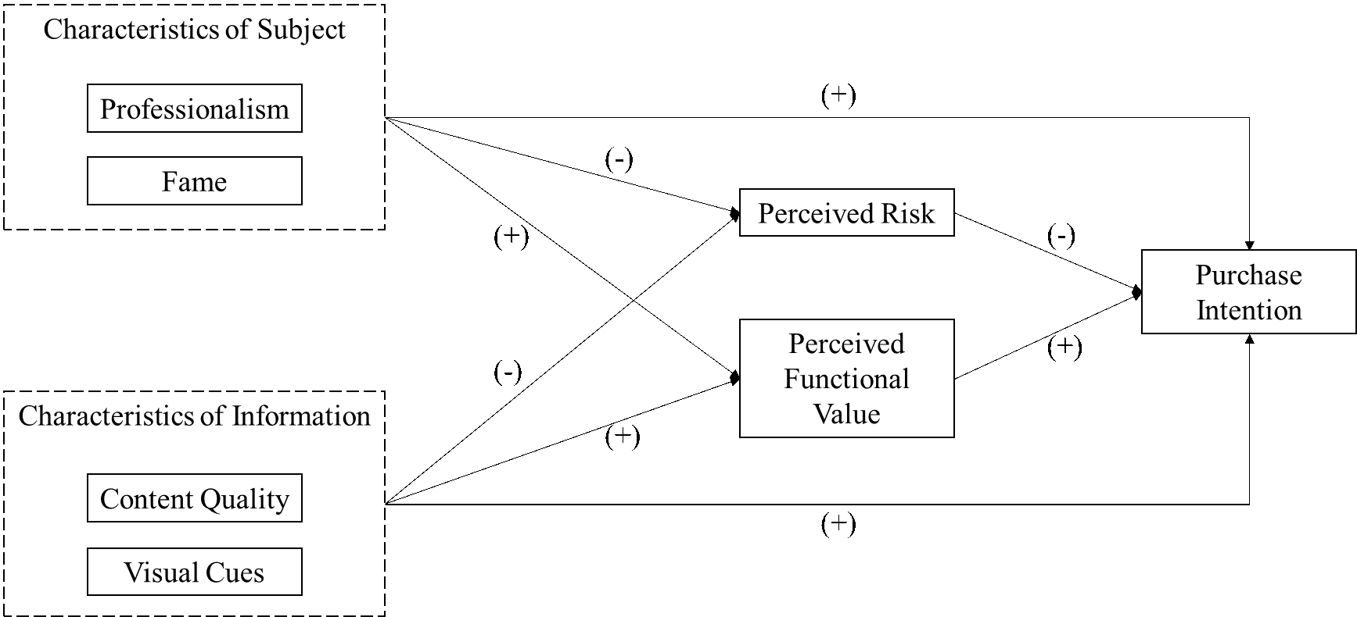
Figure 1: Theoretical Model

Slide 12
03
Research Design and Empirical Analiysis

Slide 13
Research Design:
The questionnaire was presented in the form of a Likert 5-level scale.
The respondents were asked to recall a specific experience of referring to OTE, and rated the degree of agreement with each option according to their real thoughts.
We conducted three small pre-tests, repeatedly modified or deleted unreasonable, and finally obtained 29 items.
Data Collection:
Target of our investigation: college students who have a certain understanding or reference experience of OTE.
Distribution: We used the applet Questionnaire Star to edit the questionnaire, and distributed the questionnaire to WeChat Moments and college students' communication groups across the country.
Pre-survey: We modified and adjusted the questionnaire three times. The last pre-survey questionnaire achieved high reliability and validity and could be used for further analysis.
Formal survey: We obtained 390 questionnaires. One of the questionnaires was not filled out by college students, and the answers of the two questionnaires were repeated too much. After excluding invalid questionnaires, a total of 387 valid questionnaires were collected.
Analysis tools: SPSS Statistics 26 and AMOS 23.0

Slide 14
Descriptive Statistical Analysis
As can be seen from Table 1, the male to female ratio of the respondents is 7:3. Although the consumer group of beauty products is still dominated by women, the demand of men for beauty products is becoming increasingly prominent, which illustrates the economics of male beauty has great potential. The age distribution of the respondents is mainly concentrated between 18 and 25 years old, that is, undergraduates and master students are the majority, accounting for 74.9%. In addition, we can also learn that the respondents with an average monthly living expenses of less than 2000 yuan are the most, nearly half of the total number. We speculate that the behavior of choosing beauty products by referring to OTE may be related to income.
Table 1: Descriptive Statistical Analysis

Slide 15
Table 2: Reliability and Validity Test Results
Reliability and Validity Test
The purpose of reliability analysis is to study the reliability of measurement results and explore whether there is internal consistency in these measurement results. As can be seen from Table 2, the CITC values of all items are greater than 0.5, indicating that the item settings are relatively reasonable. Cronbach's α of all variables is greater than 0.7, indicating good internal reliability of the scale.
Validity refers to the accuracy of the measurement results in reflecting the measurement objectives. The KMO values of all variables are greater than 0.7, and the combined reliability is greater than 0.7, indicating that the data of this scale has high convergent validi

Slide 16
Model Fitting
To evaluate whether the previously proposed theoretical model is tenable, we used AMOS 23.0 to calculate the fitting index of the structural model. Above we have demonstrated that the data of each dimension of this scale has high convergent validity. Therefore, in the structural equation modeling analysis, we use the mean of scores under each dimension as the explicit variable. Table 3 shows that the model has a good fit.
Table 3: Model Fitting Results

Slide 17
Path Analysis
Since the path analysis of the four dimensions of OTE on purchase intention reflects the direct effect rather than the total effect, the test results of H1-H4 can only be obtained in the mediation effect analysis.
It can be seen from Table 4 that H8a is not supported at a significance level of 0.01.

Slide 18
Mediation Effect Test
We conducted hypothesis verification with reference to the mediation effect testing process proposed by Wen and Ye (2014).
As can be seen from the Table 5, our study does not support H7d, H10a, and H10d, while other mediation effects hypotheses are supported.
In addition, We can also test the hypothesis of H1-H4 by observing the value of the total effect c. From the table below, it can be seen that at a significance level of 0.01, H1-H3 are supported, but H4 is not supported.
Table 5: Mediation Effect Test Results

Slide 19
04
Conclusion and Future Work

Slide 20
Results and Discussion
Most of the hypotheses proposed by our research institute have been supported. So we will specifically discuss and explain why several of these assumptions are not supported.
H8a: Professionalism => Perceived Functional Value
H10a: Professionalism => Perceived Functional Value => Purchase Intention
One possible explanation is that most college students do not have the corresponding knowledge of chemical substances contained in beauty products. Therefore, although the subject uses professional vocabulary as much as possible to show professionalism, college students cannot change their judgment on the functional value of the product.
H4: Visual Cues => Purchase Intention
H7d: Visual Cues => Perceived Risk=> Purchase Intention
H10d: Visual Cues => Perceived Functional Value => Purchase Intention
We found that, although the total effect of visual cues on purchase intention is not significant, the indirect effect is significant. We attempted to conduct a correlation analysis between visual cues and purchase intention and found that the two were significantly correlated. Therefore, we speculate that in addition to perceived risk or perceived functional value, there may exist important mediating variables that transmit negative effects between visual cues and purchase intention.

Slide 21
Management Implications
Operators need to create a 'living sign’
Operators need to focus on product content creation
College students need to improve their ability of information recognition
Research Limitations and Ruture Prospects
Due to the constrains of personal social circles, there are certain limitations in the representativeness of the sample in this study. Future studies can expand the sample scope, or use big data to obtain more comprehensive data to make the research results more representative.
The characteristic of OTE extracted in this study are few, and only four prominent dimensions are selected according to previous literatures. Future studies can incorporate the latest network trends to introduce more meaningful explanatory variables.
We only studied the influence of recommended OTE on purchase intention. Future research could examine dissuasive or comparative OTE.
As we mentioned before, in addition to perceived risk or perceived functional value, there may exist important mediating variables that transmit negative effects between visual cues and purchase intention. Future studies can try to identify this specific mediating variable or explore other possible explanations.

Slide 22
Thank You!
Notes:
幸运日素材 淘宝店：https://shop145643496.taobao.com

