Slide 1

IMPACT OF ARTIFICIAL INTELLIGENCE (AI) IN ENHANCING PRODUCTIVITY AND REDUCING STRESS AMONG STUDENTS
Eldon Y. Li ¹
Anila Jan ^{2,*}
National Chung Cheng University, Chiayi, Taiwan

Slide 2

Contents
1
Abstract
2
Introduction
3
Material and methods
4
Discussion
5
Conclusion

Slide 3
Abstract
  Explores AI's effects on education, emphasizing student productivity and stress reduction.
  Reviewed 15 articles showcasing AI's personalization, automation, and support role.
  AI enhances time management and reduces stress by offering emotional support.
  Offers valuable insights for AI integration in education.

Slide 4
Research Objectives
  To Evaluate AI's impact on student productivity in education.
  Explore AI's role in lowering student stress in education.
  Analyze AI's potential to transform traditional education methods.
  Examine ethical issues in AI implementation, like data privacy and bias.

Slide 5
Introduction
Boosted Productivity
  AI, like ChatGPT, enhances student productivity (Mondal, 2023).
Personalized Learning
  AI offers tailored guidance, improving comprehension and performance (Mondal, 2023).
Reduced Student Stress
  Instant feedback and real-time support lower stress levels (Mondal, 2023).

Slide 6
Streamlined Tasks
  AI simplifies research, organization, and proofreading (Mondal, 2023).
Employment Opportunities
  AI creates job opportunities in education, healthcare, and design (Fauzi, Tuhuteru et al., 2023).
Well-being and Learning Balance
  AI supports personalized education and fosters a balanced learning environment (Fauzi, Tuhuteru et al., 2023; Morales-Rodríguez, Martínez-Ramón et al., 2021).

Slide 7
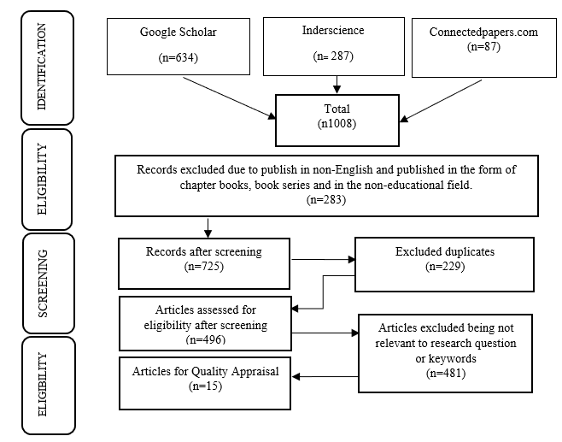
Methodology
  The PRISMA guidelines refer to the Preferred Reporting Items for Systematic Reviews and Meta-Analyses. These guidelines were published in 2009 (Moher, Liberati et al. 2009).

Slide 8
Methodology
  The findings provide valuable insights into how artificial intelligence (AI) can profoundly impact students' productivity and stress levels after thoroughly reviewing 15 articles.
  Uncovered significant aspects and insights that highlight the potential benefits of AI in education

Slide 9

DISCUSSION
  Personalized Learning and Academic Support
  Automation of Administrative Tasks
  Emotional Support and Stress Reduction
  Ethical Consideration

Slide 10
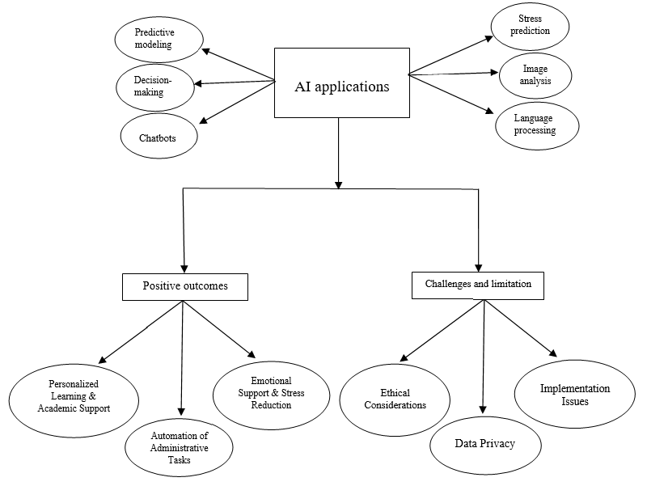
Figure 2 Key Findings and Cause-Effect Relationships of AI Applications in Education

Slide 11
CONCLUSION
  AI enhances student productivity and reduces stress in education.
  Ethical considerations like data privacy and bias need attention for responsible AI implementation.
  Collaboration among institutions, policymakers, and researchers is crucial for AI's success.
  Future research should focus on long-term effects, student engagement, ethics, attitudes, special populations, and well-being in AI-driven education.

Slide 12

Paper ID: 9
THANK YOU FOR LISTENING!
Eldon Y. Li
Anila Jan
Chair Professor, National Chung Cheng University, Chiayi, Taiwan
Doctoral Student, National Chung Cheng University, Chiayi, Taiwan

