Slide 1
Assessing Political skill through Reputation on e-word-of-mouth in social media
Jao-Hong Cheng ¹
*Chun-Chieh Chang ²
Yuan-Kai Chen ³
*Corresponding author
¹ Department of Information Management, National Yunlin University of Science and Technology, Douliou, Taiwan, jhcheng@yuntech.edu.tw
² Department of Information Management, National Yunlin University of Science and Technology, Douliou, Taiwan, D10523001@yuntech.edu.tw
³ Department of Information Management, National Yunlin University of Science and Technology, Douliou, Taiwan,, M10523035@yuntech.edu.tw

Slide 2
ABSTRACT
This paper presents a new model of social-political perspectives impact on eWOM. eWOM can be regarded as a key indicator about personal reputation. In this study, we examined how eWOM is influenced by reputation and how political skills affect the reputation of social media. Therefore, a research model consisting of five hypotheses is proposed, including social astuteness, networking ability, apparent sincerity, interpersonal influence, reputation and eWOM.
Keywords: Political skill, eWOM, Social astuteness, Networking ability, Apparent sincerity, Interpersonal influence, Reputation, Social media.

Slide 3
Introduction
Electronic word of mouth (eWOM) is a key measure of personal reputation in online contexts. If a person sharing information online has a good reputation, eWOM will be more effective. This relationship is moderated by political skill (Brouer, Badaway, Gallagher, and Haber, 2014). Therefore, we expect both reputation and political skill to impact eWOM.
Social influence theory (Levy, Collins, and Nail, 1998) leads us to postulate that political skill is a key individual variable influencing the effectiveness of impression management techniques.
Impression management can be defined as people’s attempts to manage or control the perceptions that others form of them (Bozeman and Kacmar, 1997; Drory and Zaidman, 2007).
As politically skillful individuals are particularly adept at making their behavior appear salient and attracting attentional focus while also building social connections with others, political skill is expected to serve as an antecedent of personal reputation (Ferris et al., 2007).
The purpose of this study is to develop an empirical model to examine how reputation affects eWOM and how this association is affected by political skill. A review of the eWOM literature, reveals that little attention has been paid to the important topic of antecedents of reputation in eWOM contexts. Therefore, this paper explores the impact of political skill on individual reputation, and the latter’s subsequent influence on eWOM. To fill the abovementioned gap in the literature, we connect the concept of political skill with that of reputation in social media settings.

Slide 4
Literature Review
Political skill - Ferris et al. (2005) define political skill as “the ability to effectively understand others at work, and to use such knowledge to influence others to act in ways that enhance one’s personal and/or organizational objectives.” They (2005) identify four critical dimensions of political skill: social astuteness, interpersonal influence, networking ability, and apparent sincerity.
Networking ability - A good networking ability helps people to position themselves to take advantage of opportunities and to obtain assets useful or necessary for personal and organizational gain (Shi et al., 2010). Making connections is an interpersonal networking process. Networking ability can also be defined as an internal cognitive process that allows individuals to strategically understand how to establish networks and position themselves within these networks to gain the greatest benefit (Brouer et al., 2014).
Social astuteness - Pfeffer (1992) describes this property as being sensitive to others, and argues that the ability to recognize others’ needs helps one to acquire things for oneself. Socially astute people are usually considered perceptive and shrewd in their dealings with others.
Interpersonal influence - Politically skillful people with a strong interpersonal influence can shape the behavior of those around them (Shi et al., 2010).
Apparent sincerity - apparent sincerity is understood to be a behavioral component of political skill (Brouer et al., 2014). One’s perceived disposition or motivation has an important influence on others’ interpretation and categorization of one’s behavior. Individuals with high levels of apparent sincerity elicit confidence and trust from those around them, because their behaviors are not perceived as disingenuous or manipulative (Ferris et al., 2007).

Slide 5
Literature Review
Reputation - Signaling theory suggests that in building one’s personal reputation, one sends signals to others in an effort to influence their perceptions and meaning making (Spence, 1974). Reputation is defined as “a perceptual identity reflective of the complex combination of salient personal characteristics and accomplishments, demonstrated behavior, and intended images presented over some period of time as observed directly and/or as reported from secondary sources” (Ferris et al., 2003, p. 215). Reputation has long been recognized as a key driver of content contribution on social media (Chen et al., 2011a; Forte et al., 2009; Wasko and Faraj, 2005). Individuals can cultivate a good reputation in many areas of everyday life (Zinko et al., 2011).

Slide 6
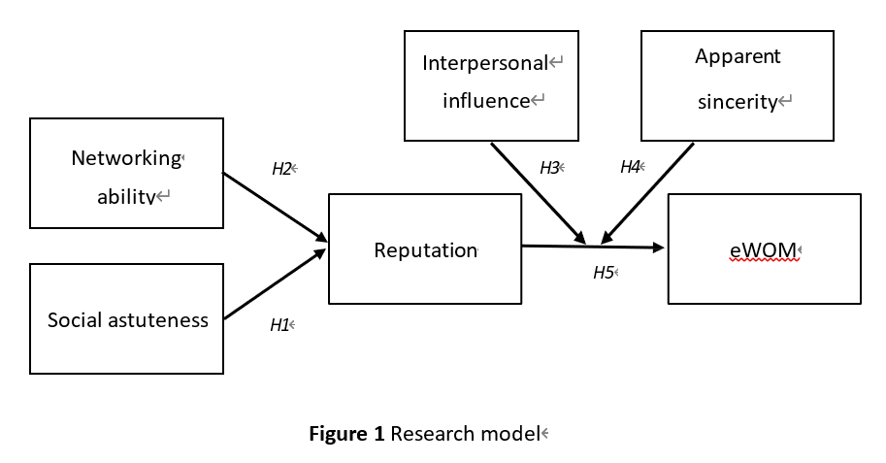
Theoretical framework and hypothesis development
H1: Social astuteness is positively related to reputation.
H2: Networking ability is positively related to reputation.
H3: Interpersonal influence increases the positive effect of reputation on eWOM.
H4: Apparent sincerity increases the positive effect of reputation on eWOM.
H5: Reputation is positively related to eWOM.

Slide 7
Research method
To develop the survey instrument, a pool of items was first identified from the literature to measuring the constructs of the research model. Then, data from a survey sample were used to assess the instrument’s validity and reliability and test the relationships hypothesized in the research model.

Slide 8
Data analysis and findings
Software AMOS 21.0 was used to conduct structural-equation modeling (SEM) to test and analyze the relationships hypothesized in the research model. The aim of SEM is to examine the relationships between a set of posited constructs simultaneously; each construct is measured by one or more observed items (measures). SEM is used to analyze two models: a measurement model (confirmatory factor analysis, CFA) and a structural model (Anderson & Gerbing, 1988). The measurement model specifies the relationships between the observed measures and their underlying constructs, which are allowed to inter-correlate, and the structural model specifies the posited causal relationships between the constructs.

Slide 9
Conclusions
We expect both reputation and political skill to impact eWOM.
The above is the preliminary structure and concept, which will be completed in the future.

Slide 10
END

