Slide 1





PAPER ID: 3
FOSTERING FINTECH ADOPTION IN GROWING ECONOMIES:
OPPORTUNITIES, CHALLENGES, AND STRATEGIES
ELDON Y. LI, USAMA ZAFAR*

Slide 2



AGENDA
  ABSTRACT
  INTRODUCTION
  METHODOLOGY
  CHALLENGES
  OPPORTUNITIES
  STRATEGIES
  CONCLUSION

Slide 3



ABSTRACT
  Rising Fintech adoption in developing countries for inclusion and growth.
  Distinct challenges and opportunities in fostering Fintech in emerging economies.
  Systematic review to assess current state, challenges, and strategies.
  Comprehensive search in Scopus and Web of Science and then selected 12 articles.

Slide 4
INTRODUCTION (1/2)
- Fintech has revolutionized financial services in developed countries, offering convenience and efficiency.
- In growing economies, fintech adoption brings unique challenges and opportunities for financial inclusion and economic growth. Addressing these challenges is crucial for reaping the full benefits.
- This research conducts a systematic literature review to explore fintech adoption dynamics in developing countries.

Slide 5
INTRODUCTION (2/2)
Valuable insights are offered for policymakers, regulators, and practitioners involved in fostering fintech in growing economies.
  Robust security measures are essential to protect sensitive data and maintain trust in financial transactions.
  Advocate for a comprehensive approach involving technology, regulations, and user awareness.
  Collaboration among financial institutions, technology providers, regulators, and consumers is crucial for safe fintech adoption.

Slide 6

METHODOLOGY
  PRISMA (Preferred Reporting Items for Systematic Review and Meta-Analysis) Guidelines provide a standardized framework for reporting systematic reviews and meta-analyses.
  Improve the transparency, clarity, and completeness of research in these fields.
  Cover aspects like research questions, study design, search strategy, data extraction, study quality assessment, and result interpretation.
  Ensures a rigorous and consistent approach in research to enhances credibility and reproducibility and enables the evaluation and comparison of studies in specific fields.

Slide 7
METHODOLOGY
Search Strategy
  A comprehensive electronic database search was conducted using Scopus and Web of Science.
  Keywords and search strings, including Boolean operators (AND and OR), were used to identify relevant articles.
  The Scopus search string included terms related to fintech and financial inclusion, while the Web of Science search string encompassed similar terms for a thorough review.

Slide 8
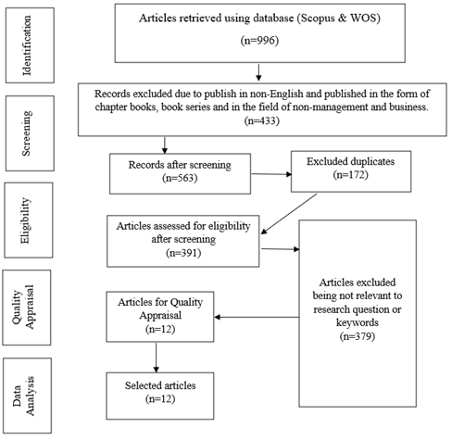
METHODOLOGY
Selection Criteria

Slide 9

SELECTED ARTICLES
Opportunities
Adoption Intention of Fintech Services for Bank Users: An Empirical Examination with an Extended Technology Acceptance Model
FinTech adoption and financial inclusion: Evidence from household consumption in China
FinTech in COVID-19 and Beyond: What Factors Are Affecting Customers’ Choice of FinTech Applications
Consumer acceptance and adoption towards payment-type fintech services from a Malaysian perspective

Slide 10
SELECTED ARTICLES
Challenges
Blockchain, cryptocurrency and Fintech market growth in Malaysia
Mobile payment in Fintech environment: trends, security challenges, and services
Sustainable Development of Fintech: Focused on Uncertainty and Perceived Quality Issues
Barriers to digital payment adoption: micro, small and medium enterprises

Slide 11
SELECTED ARTICLES
Strategies
Understanding FinTech Platform Adoption: Impacts of Perceived Value and Perceived Risk
FinTech adoption and financial inclusion: Evidence from household consumption in China
Predicting Fintech Innovation Adoption: the Mediator Role of Social Norms and Attitudes
The rise of fintech: A cross-country perspective

Slide 12


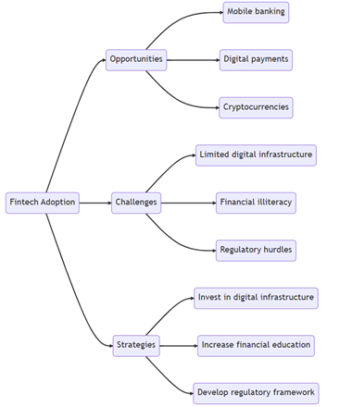
Fintech Adoption Opportunities, Challenges, and Strategies

Slide 13
CONCLUSION (1/3)
Opportunities
  Mobile Banking
  Digital Payments
  Cryptocurrencies
Enhanced Accessibility
Cost Savings
Financial Inclusion
Convenience
Speed and Efficiency
Reduced Cash Dependency
Global Accessibility
Record Keeping
Decentralization
Lower Transaction Costs
Global Accessibility
Innovation Potential

Slide 14
CONCLUSION (2/3)
Challenges
  Limited Digital Infrastructure
  Financial Illiteracy
  Regulatory Hurdles
Enhanced Accessibility
Cost Savings
Financial Inclusion
Convenience
Speed and Efficiency
Reduced Cash Dependency
Global Accessibility
Record Keeping
Decentralization
Lower Transaction Costs
Global Accessibility
Innovation Potential

Slide 15
CONCLUSION (3/3)
Strategies
  Investments in Digital Infrastructure
  Financial Education
  Develop Regulatory Framework
Enhanced Accessibility
Cost Savings
Financial Inclusion
Convenience
Speed and Efficiency
Reduced Cash Dependency
Global Accessibility
Record Keeping
Decentralization
Lower Transaction Costs
Global Accessibility
Innovation Potential

Slide 16

PAPER ID: 3
THANK YOU
FOR LISTENING
Eldon Y. Li 1
Usama Zafar 2,*
1 Chair Professor, National Chung Cheng University, Chiayi, Taiwan.
2 Doctoral Student, National Chung Cheng University, Chiayi, Taiwan.

