Slide 1
The Role and Relationship of Information Technology Capability, Supply Chain Resilience and Operation Performance in Post-Pandemic Era
WenLu Wang
National Cheng-Chi University, Taiwan
Business Administration Department
wenluwang.lw@gmail.com
2023 Oct-20th

Slide 2
Agenda
Introduction
Literature Review and Hypothesis for Modeling
Research Methodology
Data Analysis and Discussion
Conclusion

Slide 3
Introduction
The COVID-19 pandemic introduced substantial uncertainty into various aspects of life, particularly supply chains, which faced unprecedented challenges such as extended lead times, disruption in supply chain networks, and severe demand fluctuations.
In the face of supply chain fragility, supply chain resilience capabilities were emphasized as necessary to address environmental risks and operation recovery from disruption.
The ability to predict and manage supply chain risk for any unforeseen shocks and disruptions will become a critical competitive advantage for firms, enabling them to sustain operational performance.
According to the Dynamic Capability View, Information Technology (IT) capability in organization and IT system implementation can help firms to create sustained competitive advantage and enhance performance
The objective of this research is to verify the positive relationship between IT capability, supply chain resilience and operation performance, and the role of IT capability to supply chain resilience influence on operation performance

Slide 4
Literature Review
Dynamic Capability:
Firm’s competitive advantage is seen as dependent on a unique process and determined by the company's specific asset position (Teece et al., 1997).
Based on the dynamic capability perspective, knowledge resource is also considered a unique and valuable resource that is linked to a company's competitiveness (Barney, 1991)
Knowledge Management (KM), the absorptive ability of knowledge creation and utilization in the competition can help firms to gain and maintain a competitive advantage (Liu, Ke, Wei, & Hua, 2013)
Viewing this through the lens of dynamic capabilities and integrating knowledge management, enterprises can effectively utilize their knowledge to respond to changing market conditions.
IT support for knowledge management can directly enhance organizational knowledge management and capabilities, enabling the integration and reconfiguration of internal and external organizational resources to adapt to changing environments, thus enhancing company performance.

Slide 5
Literature Review
Operational Performance:
Supply chain management serve as an integrated performance indicator. These indicators encompass aspects such as service, speed, lead time, order flexibility, cash flow cycle and the link between supply chain operations and financial performance (Hausman, 2004).
For customer satisfaction, internal supply chain performance also needs cost-effective management encompassing transportation and handling costs, manufacturing costs and inventory, all of which will directly influence financial performance (Gligor, Esmark, & Holcomb, 2015).
In terms of enterprise supply chain performance measurement, the Supply Chain Council (SCC) developed the SCOR model in 1996. SCOR has evolved annually up to 2022 and has been updated to the fourteenth edition in line with changes during the COVID-19 pandemic.
Economic, include:
Cost: operating costs, labor and manufacturing costs, transportation costs associated with supply chain processes.
Profit: margin after deducting operating expenses and tax costs
Assets: maximizing investment and return on assets
SCOR v. 14th | Performance Attributes
Resilience | Reliability
 | Responsiveness
 | Agility
Economic | Costs
 | Profit
 | Assets
Sustainability | Environmental
 | Social
Data Resources: ASCM website, http://ascm.org

Slide 6
Literature Review
Supply Chain Resilience
When companies are faced with uncertainty, they need to be able to adequately manage supply chain to maintain normal operating levels. Supply chain resilience encompasses proactive monitoring and elimination of potential disruptions, recovery and the rapid restoration of normal business operations when unforeseen events occur. (Christopher & Peck, 2004; Park, 2011).
To efficiently and effectively mitigate supply chain disruptions caused by unexpected event, companies must develop resilient supply chain organizations and capabilities to enhance performance (Christopher & Peck, 2004; Pettit, Croxton, & Fiksel, 2013; Ponomarov & Holcomb, 2009)
With the globalization and the advent of Industry 4.0, the risk of these disruptions will have a higher impact on the operation of enterprises due to the ripple effect in the supply chain (Dolgui, Ivanov, & Sokolov, 2017).
According to the data research, performance indicators such as revenue and profitability are affected by the resilience of enterprises, also the elimination of operational disruption risk is a result from supply chain resilience(Pettit et al., 2013).
Hypothesis 1 (H1): Supply Chain Resilience has a positive impact on Operation Performance

Slide 7
Literature Review
Information Technology Capability
The drive of Industry 4.0 and the capabilities of Information Technology (IT) have transformed supply chain operation. As a result, IT applications have helped supply chains transformation to virtual value chains on acceleration, adaptability, intelligence, information transparency, global connectivity, scalability, creativity and sustainability(Garay-Rondero, Martinez-Flores, Smith, Caballero Morales, & Aldrette-Malacara, 2020).
In Lee's (2014) studying in many manufacturers, IT was identified as a leading factor in the visibility of inter-organizational information systems, which has a positive impact on overall supply chain performance that measured by operational performance (H. Lee, Kim, & Kim, 2014).
Based on Resources Based View (RBV) of enterprise competitiveness perspective, the impact of big data and predictive analytics extends to improving supply chain and operational performance, while fostering employee skills and a culture of big data, ultimately leading to a positive impact on cost and operational performance (Dubey, Gunasekaran, Childe, Blome, & Papadopoulos, 2019).
Hypothesis 2 (H2): Information Technology Capability has a positive impact on Operation Performance

Slide 8
Literature Review
Information Technology Capability
In the face of environmental risks and operational disruptions, reliable information systems are critical components of supply chain resilience capabilities. These capabilities enable organizations to overcome supply chain disruptions, improve operations post-disruption, and maintain a high level of situational awareness (Hosseini & Ivanov, 2019; Tarigan et al., 2021).
To cope with these uncertain external risks, IT application, such as risk radar, through information technology, can detect changes in the supply and demand market in advance (Ivanov, Dolgui, & Sokolov, 2019).
To transform to digital supply networks, through information visibility, collaboration, IoT, Artificial Intelligence(AI), robotics, 5G and other advanced technologies like digital twins to overcome any unexpected disruptions and market uncertainty. IT capability can for sure to improve supply chain resilience and continue operations (Barykin, Bochkarev, Kalinina, & Yadykin, 2020).
In post-pandemic era, firms still suffer from coping with supply chain disruptions due to the weakness in collecting external information by internal IT usage (Gu, Yang, & Huo, 2021)
Hypothesis 3 (H3): Information Technology Capability has a positive impact on Supply Chain Resilience

Slide 9
Literature Review
Information Technology Capability
To meet the new age of fluctuations and complexity in supply chain, firm must be integrated with customer’s demand as well as to manage increasing dynamics in the business environment. Cyber-physical systems, AI and IoT, big data analytics, and cloud computing are examples of digital technologies that promote connectivity, integration, and automation within business operations (Ivanov et al., 2019).
According to Ivanov et al. (2019), as a result, the digitalization technologies and applications in supply chain be able to assist businesses to making effective decisions in case of supply chain disaster.
To analyze the relationship between supply chain resilience practices and operational performance and the moderating role of digital technologies, the result reveal that the appropriate use of digital technologies had a significant moderating impact on the aggregate level of the supply chain resilience to impact on operational performance (Alkhatib & Momani, 2023).
Hypothesis 4 (H4): Information Technology Capability moderate the relationship between Supply Chain Resilience influence on Operation Performance

Slide 10
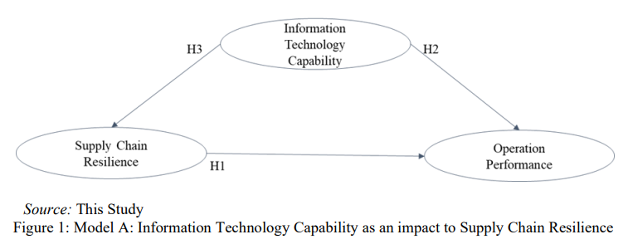
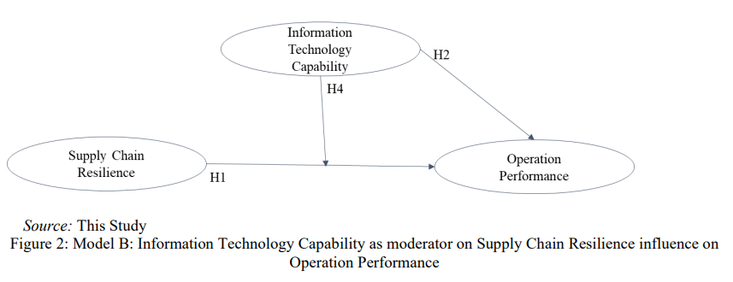
Hypothesis and Modeling
Based upon the four hypothesis, the comparison models be developed by H3 and H4 to different Model A and Model B

Slide 11
Research Methodology
This study uses structural equation modeling with Partial Least Squares (PLS) method by selected statistical software tool of SmartPLS 4.0 to do data analysis and PLS-SEM for model validation(Hair, Risher, Sarstedt, & Ringle, 2019)
The study’s population comprises manufacturing companies in Taiwan. Data collection involved the use of a questionnaire based on a five-point Likert scale with 1: strongly disagree, 2: disagree, 3: neutral, 4: agree, and 5: strongly agree.
Information Technology Capability (ITC) consists of six indicators
Supply Chain Resilience (SCR) consists of eight indicators
Operation Performance (OP) has four indicators.
Pre-test was conducted by three Taiwan manufacturing company’s employee who worked in supply chain, IT, and finance department so as to get their feedback for questionnaire’s validation.
The questionnaire was created by Google Form and distributed to Taiwan’s manufacturers with ISO certification during May 2023 to Jun 2023. Data collection received as many as 168 respondents who filled out the questionnaire, and 156 of the 168 questionnaires (93%) is effective to use for analysis.

Slide 12
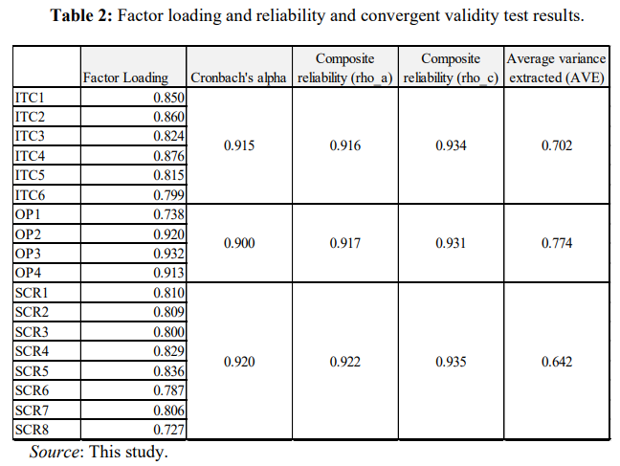
Research Methodology
Reliability and Convergent Validity
The indicator is considered convergent valid when the factor loading value exceeds 0.71(Hair et al., 2019), Cronbach alpha exceeds 0.70, composite reliability exceeds 0.6 and the AVE exceeds 0.50 (Fornell & Larcker, 1981).
The result shows all indictors of each variable which factor loading exceeds 0.71 and the Cronbach’s alpha value and composite reliability of all research variables are above 0.90. The AVE value is above 0.50. Cronbach’s alpha value, composite reliability, and average variance extracted (AVE) have met reliable requirements and reach to 0.60 above.

Slide 13
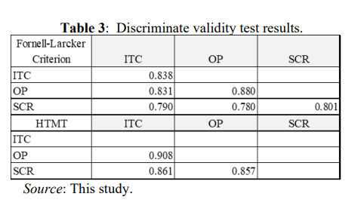
Research Methodology
Discriminate Validity
Discriminant validity refers to the extent to which a test is not related to other tests that measure different constructs.
AVE needs to be greater than the correlation coefficient under other different facets by using the relationship matrix between facets (Fornell & Larcker, 1981).
HTMT: (heterotrait-monotrait ratio of correlations), confidence interval between all facets does not contain 1
The test results showed as Table 3 that meet those two criterions.

Slide 14
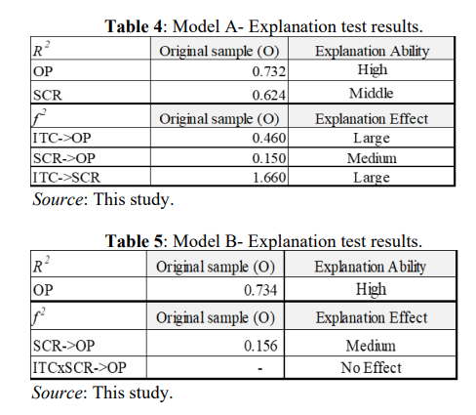
Research Methodology
Model Fits
The goodness of fit test is to seek whether the model possesses explanatory capabilities and strong predictive relevance.
The coefficient of determination R² : The larger the R² value, the better the explanatory power of the model
R² >0.67 indicates high explanation
R² >0.33 is middle
R² >0.19 is low explanatory ability
The explanation effect value f² is to evaluate whether the endogenous variables have a significant explanatory effect.
0.02< f² <=0.15 is a small effect
0.15< f² <=0.35 is a medium effect
f² > 0.35 is a large effect
According to good predictive relevance Q²: The Q² value of Model A = 0.904. The Q² value of Model B = 0.734. The prediction of Model A is better than Model B.

Slide 15
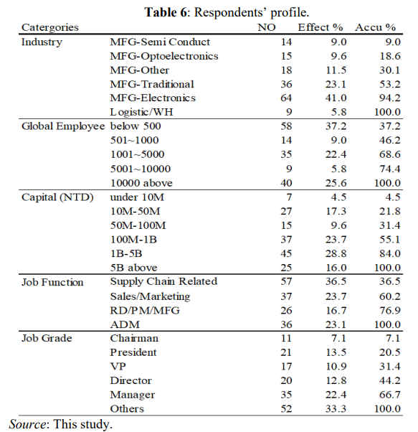
Data Analysis
Basic Information and Profile
A total of 156 questionnaires were considered valid for analysis.
The respondents consist of 46.2 % of the companies that global employee is less than 1000 and 53.8% greater than 1001 above
The capital of NTD of greater than NTD 1B is 44.9%
The respondents who in charge of various departments, includ supply chain related (36.5%) such as: customer service, production planner, material and warehousing, sales marketing (23.7%), RD/PM/MFG (16.7%), ADM (23.1%)
The grade of the positions shows a manager above is 66.7%

Slide 16
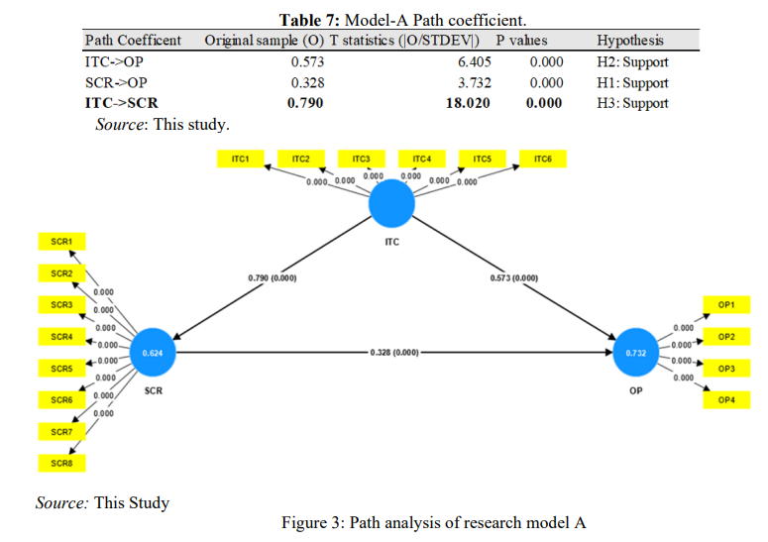
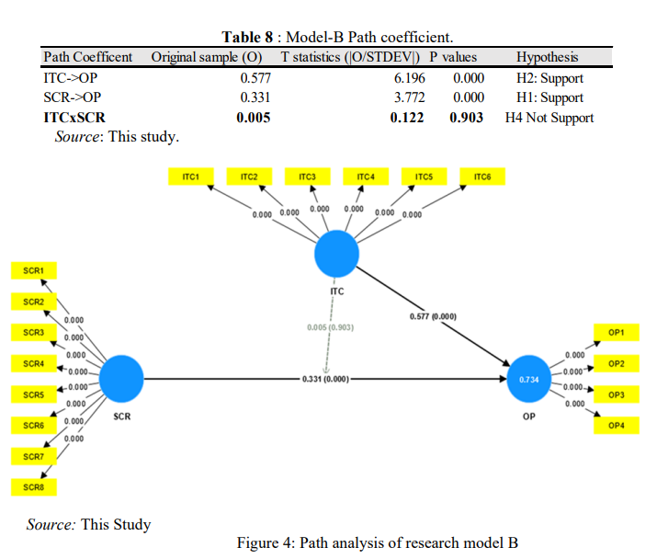
Data Analysis
Hypothesis Verification and Model Comparison Result

Slide 17
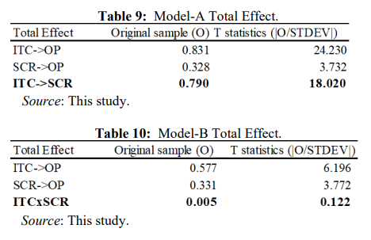
Data Analysis
Total Effect
Model A: showed on Table 9 that Information Technology Capability (ITC) impact to Operation performance (OP) is 0.831 including indirect effect 0.328 to Supply Chain Resilience (SCR). For the relationship of ITC to SCR, it apparently the impact is directly under Model A
Model B: no moderate influence (0.005) on SCR’s impact to OP. Thus, the total effect of Model B showed as Table 10

Slide 18
Discussion
The first hypothesis (H1), supply chain resilience has a positive impact on operation performance is supported. Supply chain resilience plays a pivotal role in driving supply chain performance by prevention and prediction of disruptive events and sustaining operations, even in times of global financial crises. According to this research, performance indicators such as profitability and return of investment are affected by the supply chain resilience.
The second hypothesis (H2), information technology capability has a positive impact on operation performance is supported. IT plays in the visibility of inter-organizational and external information systems, which, in turn, has a positive impact on operation performance. From enterprise competitiveness perspective, the application of IT in big data and predictive analytics can improve supply chain performance, ultimately exerting a positive influence on operational performance.
The third hypothesis (H3), information technology capability positive affects supply chain resilience is supported. The useful information generated by big data analysis, digital twins, and AI enables enterprises to use accurate and real-time information to make action decisions against disruption and risk, overcome future similar disruptions, and address market uncertainty to improve supply chain resilience and continue operations

Slide 19
Discussion
The first hypothesis (H1), supply chain resilience has a positive impact on operation performance is supported. Supply chain resilience plays a pivotal role in driving supply chain performance by prevention and prediction of disruptive events and sustaining operations, even in times of global financial crises. According to this research, performance indicators such as profitability and return of investment are affected by the supply chain resilience.
The second hypothesis (H2), information technology capability has a positive impact on operation performance is supported. IT plays in the visibility of inter-organizational and external information systems, which, in turn, has a positive impact on operation performance. From enterprise competitiveness perspective, the application of IT in big data and predictive analytics can improve supply chain performance, ultimately exerting a positive influence on operational performance.
The third hypothesis (H3), information technology capability positive affects supply chain resilience is supported. The useful information generated by big data analysis, digital twins, and AI enables enterprises to use accurate and real-time information to make action decisions against disruption and risk, overcome future similar disruptions, and address market uncertainty to improve supply chain resilience and continue operations

Slide 20
Discussion
The fourth hypothesis (H4), information technology capability moderate the relationship between supply chain resilience influence on operation performance is not supported. In post-pandemic era, there could be several reasons why information technology capability may not moderate the relationship between supply chain resilience and operational performance as strongly as it might have in the past.
Normalization of Resilience: In the post-pandemic era, supply chain resilience may have become a more standard and ingrained aspect of business operations. Companies may have already made significant investments in enhancing their supply chain resilience, which could reduce the moderating effect of information technology capabilities.
Advanced Technology Adoption: Companies that were previously lagging in information technology capabilities may have caught up or invested heavily in these capabilities in response to the disruptions caused by the pandemic
Market and Regulatory Changes: External factors, such as changes in regulations or customer preferences, may have shifted the focus away from IT capabilities as the primary moderator of resilience and operational performance.

Slide 21
Conclusion
The primary objective of this study is to examine the impact of IT capability and supply chain resilience, which is a crucial dynamic capability to influence on operation performance and verify the IT capability role to supply chain resilience is direct or moderate relationship.
Supply chain resilience represents a company’s ability to effectively manage human resources properly and have a reliable system for overcoming disruptions in the supply chain. This includes the capacity to normalize operations following a disruption, respond swiftly to vulnerabilities and supply chain disruptions, and return o normal conditions.
IT capabilities play a pivotal role to keep the highly awareness of external changes. Leveraging advanced technologies can anticipate and strengthen supply chain resilience and aware of the vulnerability of their supply chain to quickly response upon global shocks. This research confirms that IT capabilities are essential for enhancing supply chain resilience and positively impacting operational performance.

Slide 22
Conclusion
Practice insight
This research offers practical insights for manufacturing companies regarding which capabilities they should prioritize building. It strongly recommends that organizations invest in IT strategy, encompassing both technology and organizational aspects, starting immediately. It‘s crucial to recognize that the relationship between supply chain resilience, IT capabilities, and operational performance is highly contextual and can vary from one industry or organization to another, even the post-pandemic era is still evolving, and the long-term effects on supply chains and technology are progressing and on-going.
Limitation and Suggestion
It’s essential to acknowledge the limitations of this survey only on manufacturing companies in Taiwan and only three variables are selected. Controllable variables, firm’s size and industries, how to impact on those three variables are not further analysis in this sturdy.
Further studies to other countries on similar topics are encouraged to incorporate additional variables, such as supply chain agility, digital transformation, and sustainability of environmental, social responsibility to evaluate operational performance across variant industries.

Slide 23
End of Presentation Thanks for Your Listening

